Slide 1
Generative Adversarial Networks (GANs)
Josh Zhanson

Slide 2
Two main types:
Generative and Discriminative

Slide 3
Discriminative Model
Discriminates between two different classes of data
Example: convolutional neural net that outputs 1 if input is a human face, 0 if not

Slide 4
Generative Model
Generates new data that fit the distribution of the training data
Example: Gaussian Mixture Model (GMM) can generate new random points that pretty much match the training distribution

Slide 5
But finding a generative model for training data is calculation heavy:

Slide 6
Calculations include:
Maximum-likelihood
Marginal probabilities
Partition functions
Most-likely estimates
Etc.

Slide 7
Possible if finding a simple GMM, but prohibitive with deep neural nets...

Slide 8
Enter adversarial training!

Slide 9
For training data: X ⊂ ℝ^{d}, we have
Generator g: ℝ^{n}→ℝ^{d}
Discriminator d: ℝ^{d}→{0,1}
Notes:
The generator will be tasked with taking in a given sample from a standard random distribution (e.g. a sample from an n-dimensional Guassian) and producing a point that looks sort of like it could come from the same distribution as X. The discriminator, on the other hand, will be tasked with discriminating between samples from the true data X and the artificial data generated by g. Each model is trying to best the other - the generator's objective is to fool the discriminator and the discriminator's objective is to not be fooled by the generator.

Slide 10
But both g and d are neural nets!

Slide 11
We train them both, alternating between the two
Generating/discriminating can be expressed as loss function

Slide 12
Modeled as a zero-sum or minimax game
i.e. counterfeiter vs. police

Slide 13
Eventually, the generator becomes good at fooling sophisticated trained discriminators
In practice, us!

Slide 14
Advantages:
Generating artificial data indistinguishable from real data by a neural net = generating realistic data
Doesn’t require probability computations like maximum likelihood approach

Slide 15
Disadvantages:
Hard to train, no closed form loss function like log-loss or mean squared error
Therefore, a lot more trial and error, really complex tasks difficult, require a lot of hyperparameter tuning

Slide 16
Versus Variational Autoencoders (VAEs)
“VAEs use log-likelihood to optimize, can use to evaluate quality of model
But injected noise + imperfect reconstruction + standard decoder = blurry images”

Slide 17
“VAEs optimize likelihood (always probability mass from estimated data manifold) while GANs optimize something else (can be good with very sharp estimated density function even if does not perfectly coincide with data density), both an advantage and a disadvantage”
Notes:
Maximizing likelihood yields an estimated density that always bleeds probability mass away from the estimated data manifold. GANs can be happy with a very sharp estimated density function even if it does not perfectly coincide with the data density (i.e. some training examples may come close to the generated images but might still have nearly zero probability under the generator, which would be infinitely bad in terms of likelihood)

Slide 18
“GANs tend to be much more finicky to train than VAEs, not to mention that we do not have a clear objective function to optimize, but they tend to yield nicer images.”
-Yoshua Bengio

Slide 19
VAEs vs. GANs (OpenAI)
VAEs, log time
GANs, linear time

Slide 20
Issues with Monte Carlo (GANs don’t need it, Boltzmann machines rely on it)

Slide 21
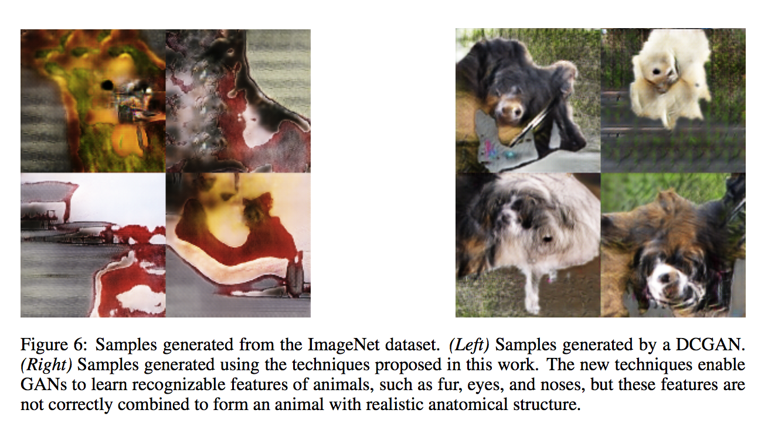
“Boltzmann machines have never really scaled to realistic tasks like ImageNet. GANs are at least able to learn to draw a few messed up dogs when trained on ImageNet.”
-Ian Goodfellow
“Improved Techniques for Training GANs”
arXiv:1606.03498 [cs.LG]

Slide 22
Do GANs converge?
Ian Goodfellow: “Unclear, but probably most important question”
In practice on small samples, sometimes, large samples, so far, never
Notes:
This is probably the most important question about GANs, both in terms of theory and practice. In terms of theory, it would be great to derive a set of conditions under which they converge or don’t converge. In terms of practice, it would be great to modify them in a way that makes them converge consistently.
This paper gives some conditions under which simultaneous gradient descent on two player’s costs will converge: http://robotics.eecs.berkeley.ed...
GANs never satisfy those conditions because the Hessian of the generators costs is all zeros at equilibrium. However, the conditions in this paper are sufficient conditions, not necessary conditions, so it’s possible that GANs can converge anyway.

Slide 23
Ian Goodfellow’s research direction: the convergence problem
“The basic issue is that all the theory says GANs should be great at the Nash equilibrium, but gradient descent is only guaranteed to get to the Nash equilibrium in the convex case. When both players are represented by neural nets, it’s possible for them to keep adapting their strategies forever without actually arriving at the equilibrium.”

Slide 24
Adequate live demo:
http://cs.stanford.edu/people/karpathy/gan/

Slide 25
Better demo code source:
https://gist.github.com/Newmu/4ee0a712454480df5ee3
Run on
https://github.com/llSourcell/Generative-Adversarial-Network-Demo

Slide 26
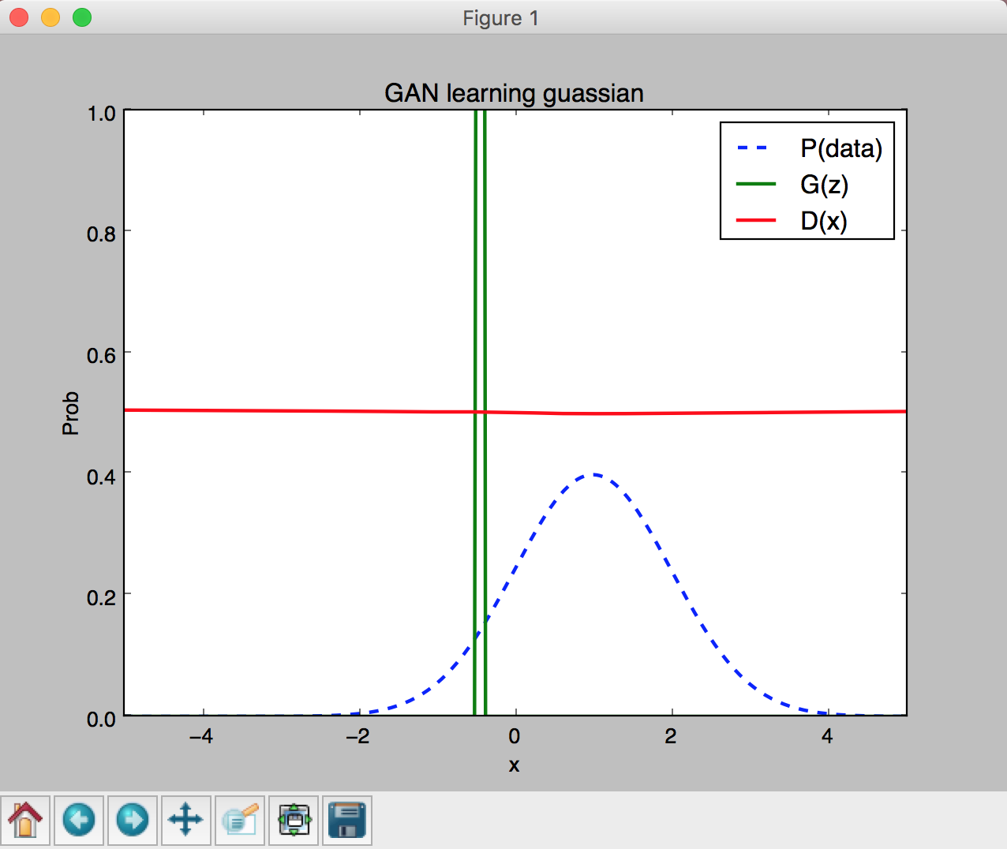
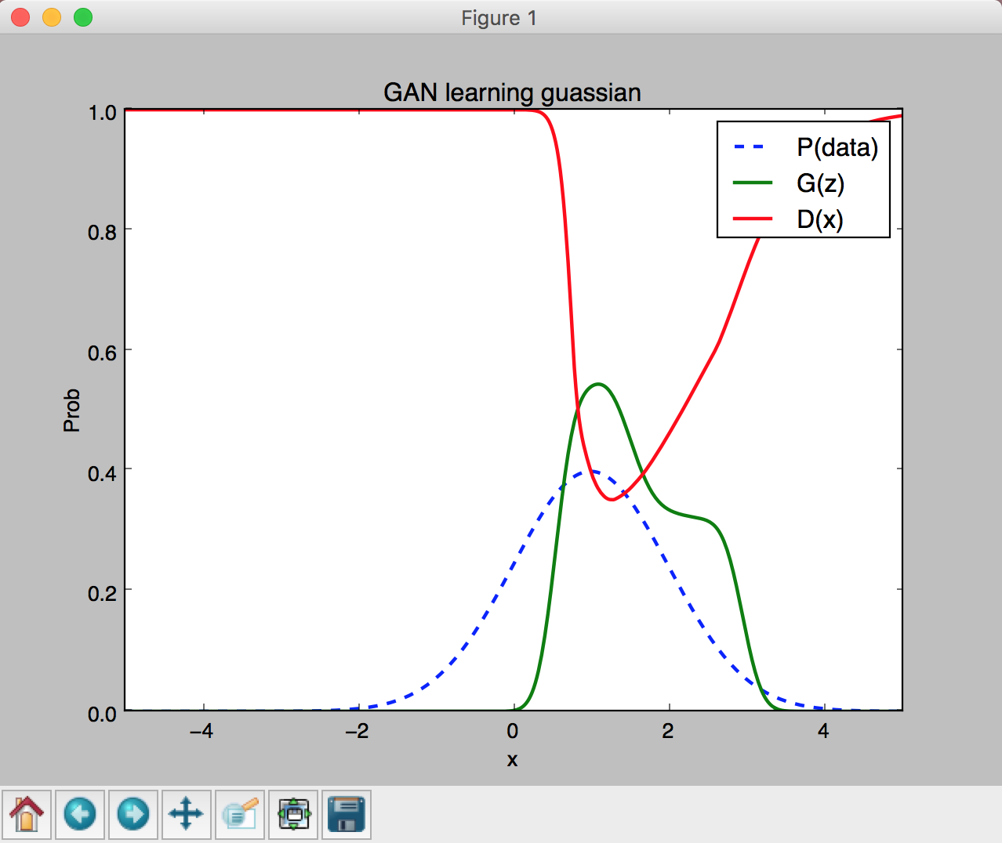
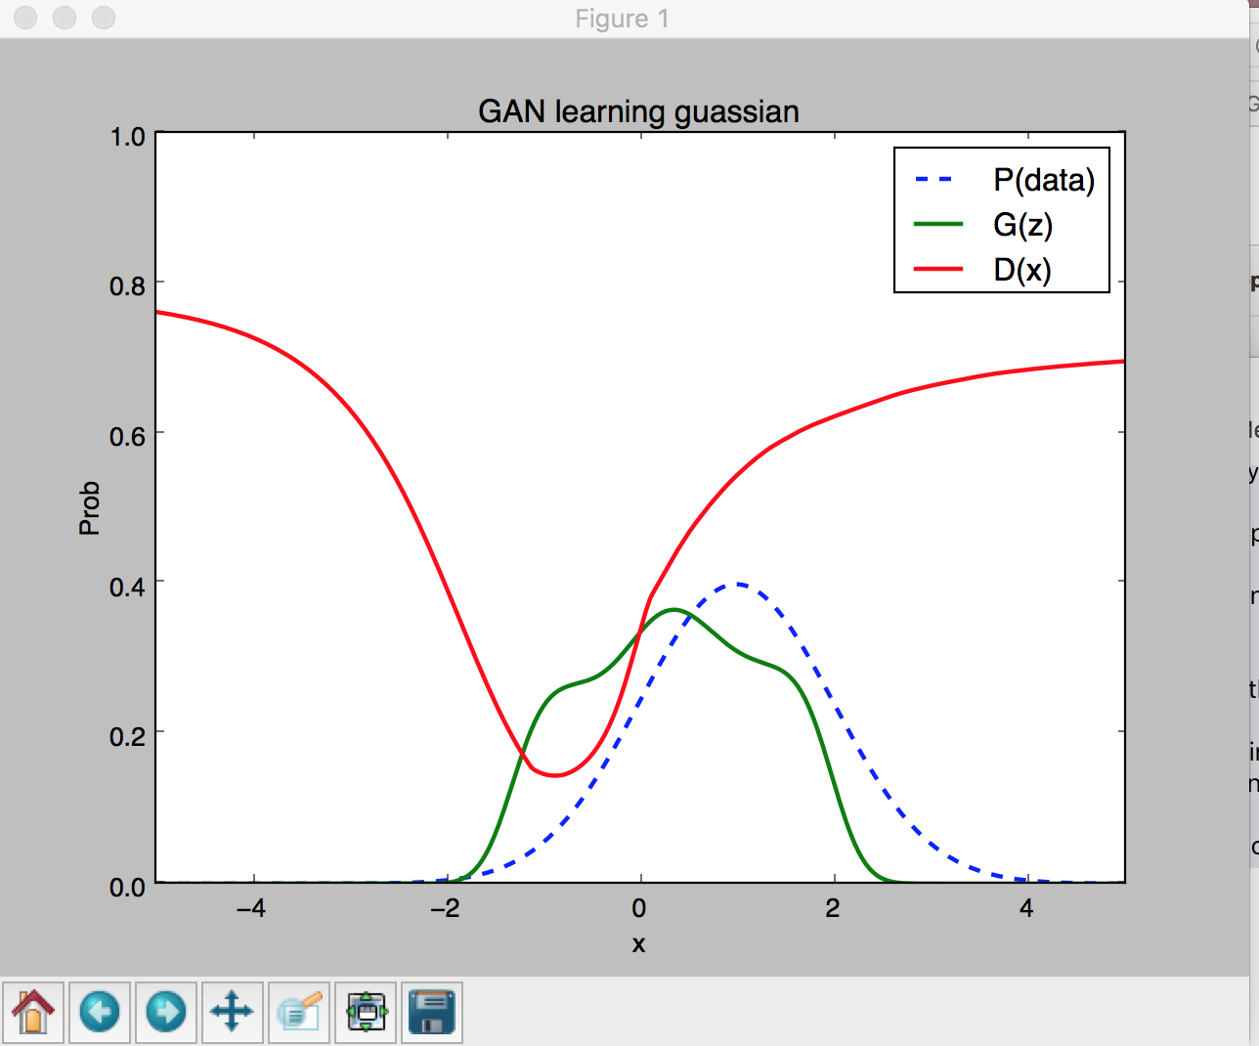
Initialization
90 epochs
250 epochs

Slide 27
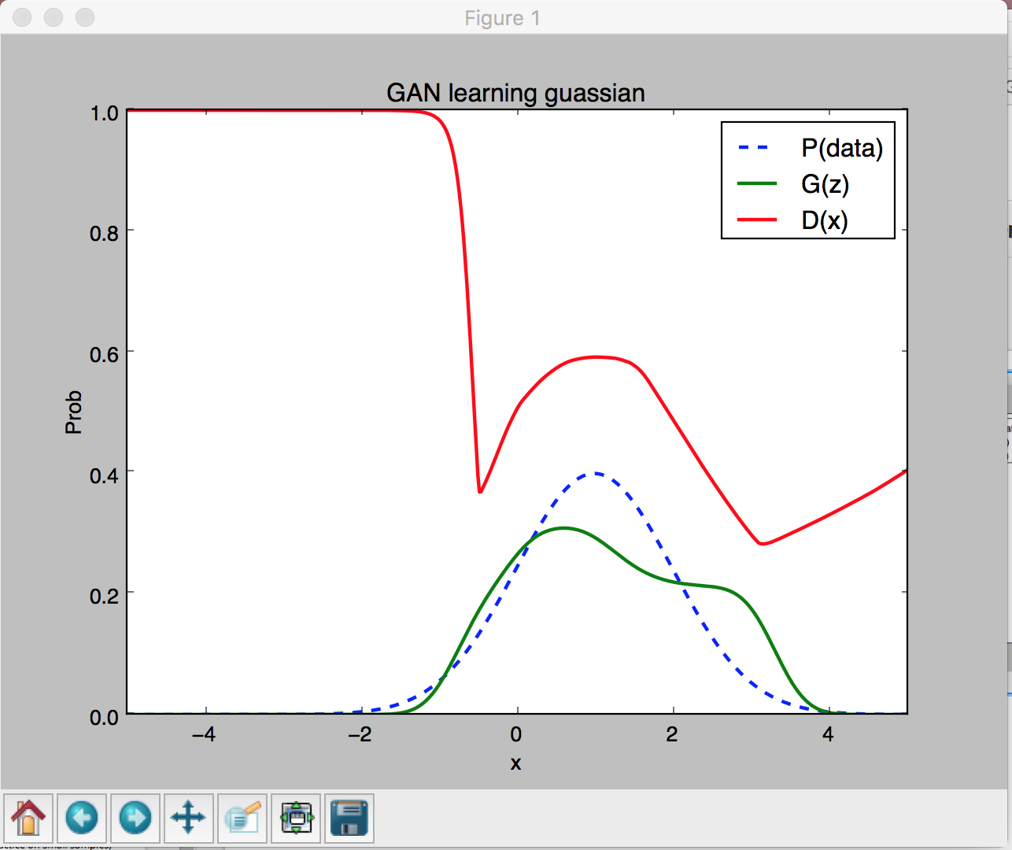
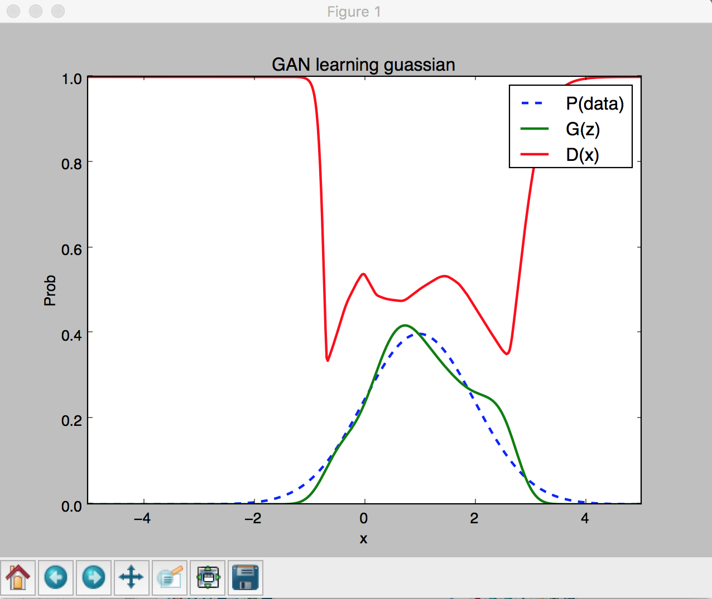
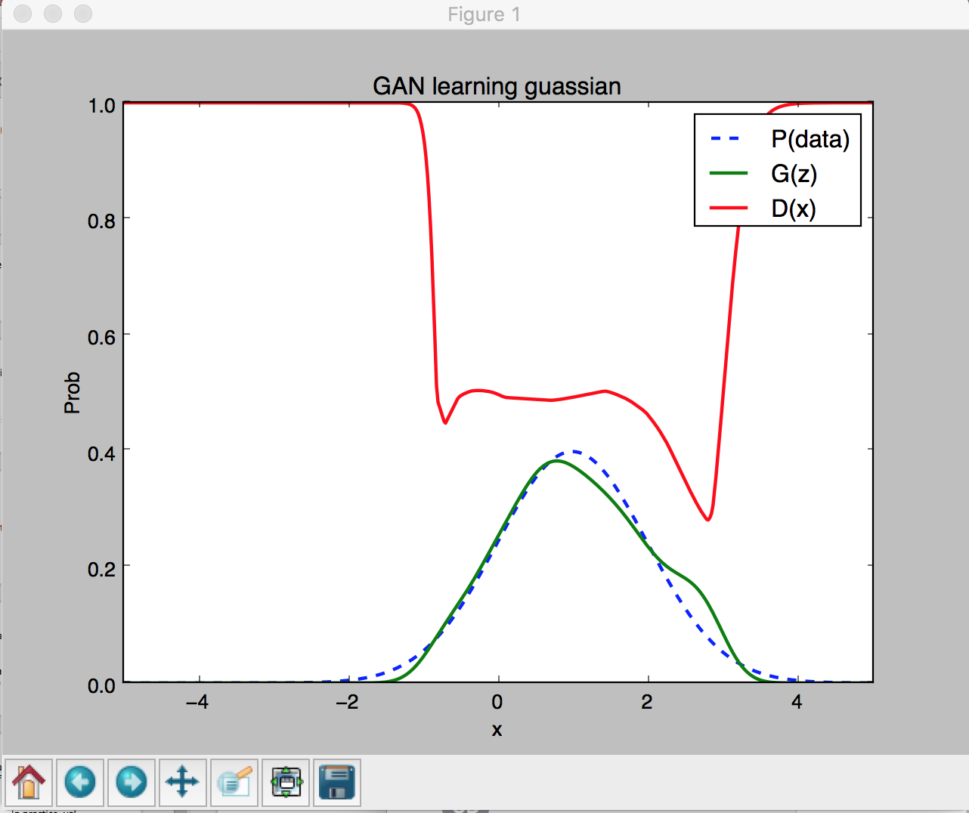
500 epochs
1000 epochs
1500 epochs

Slide 28
Results, Important Papers (further reading)

Slide 29
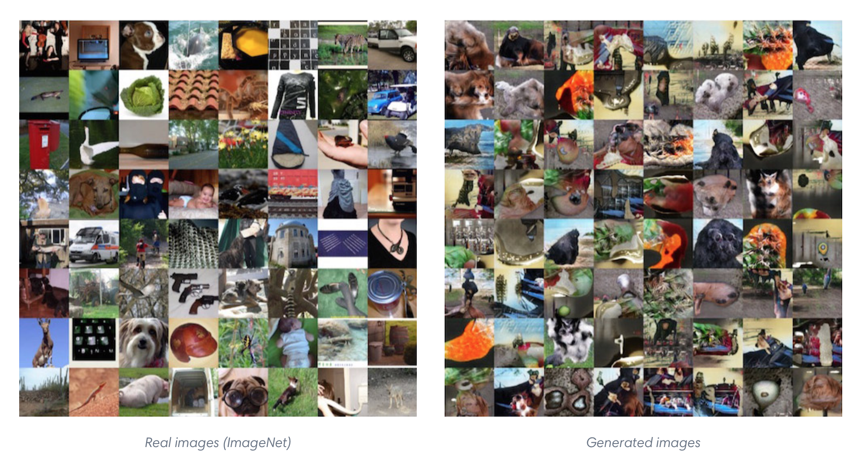
OpenAI ImageNet Samples

Slide 30
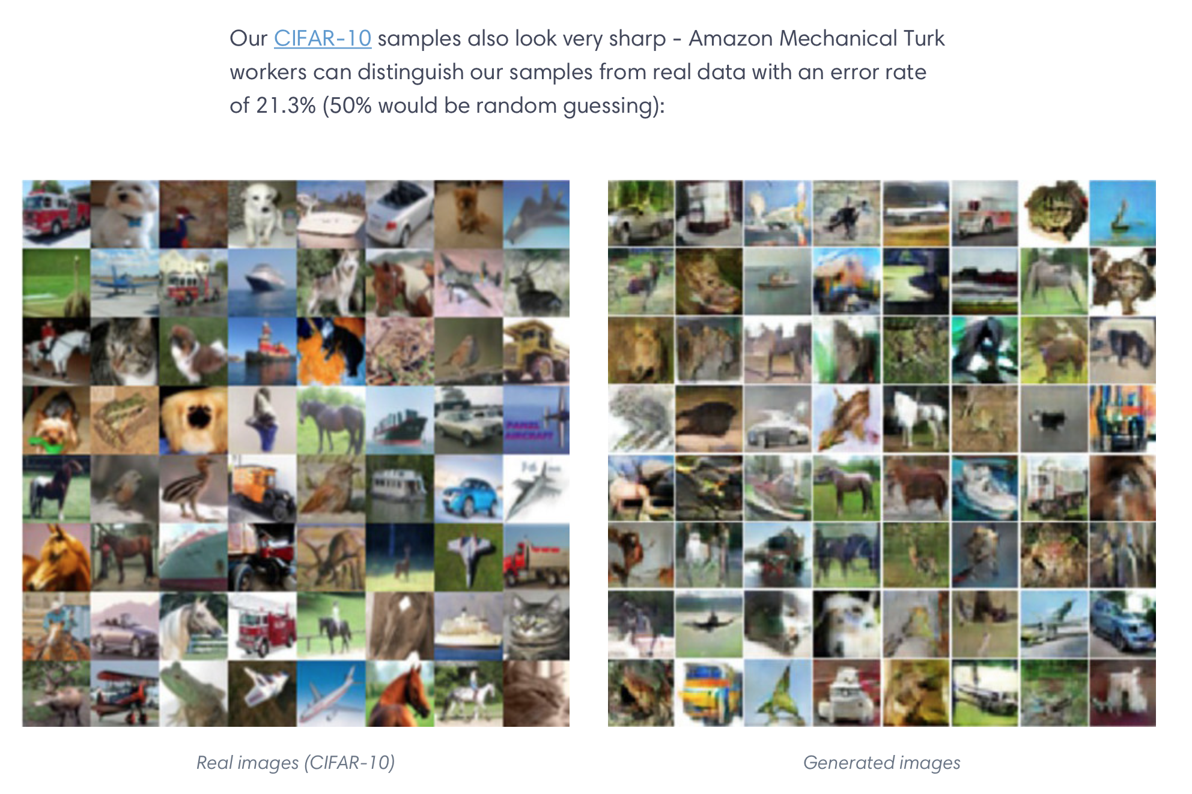
OpenAI CIFAR-10

Slide 31
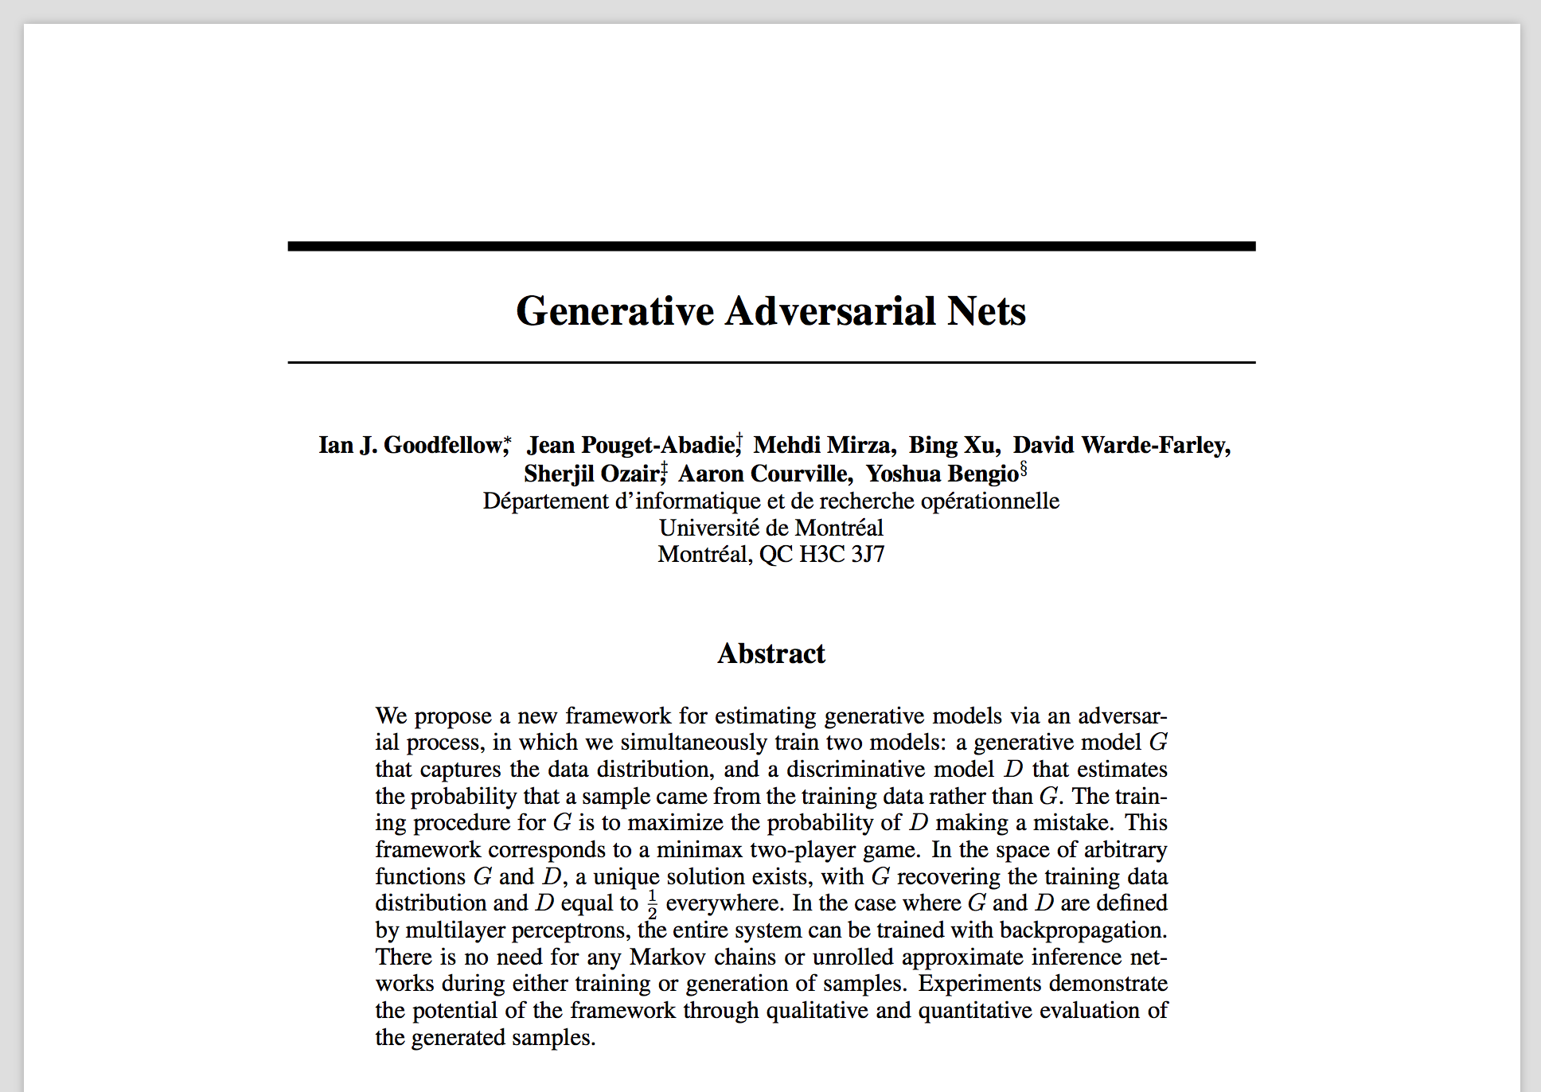
“Generative Adversarial Nets”

Slide 32
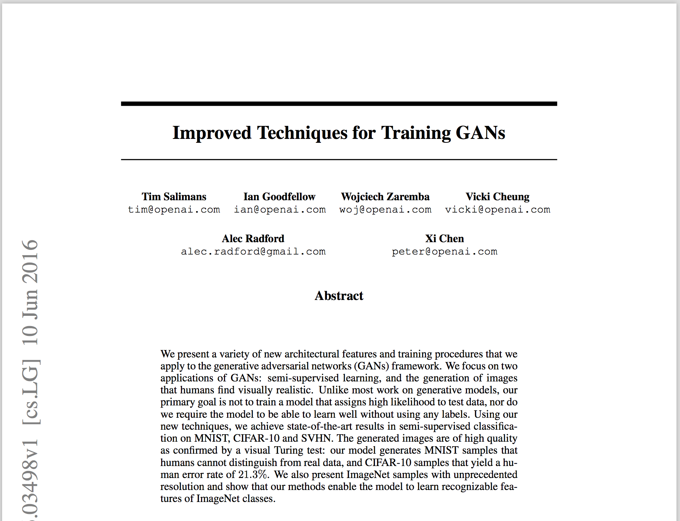
“Improving Techniques for Training GANs”

Slide 33
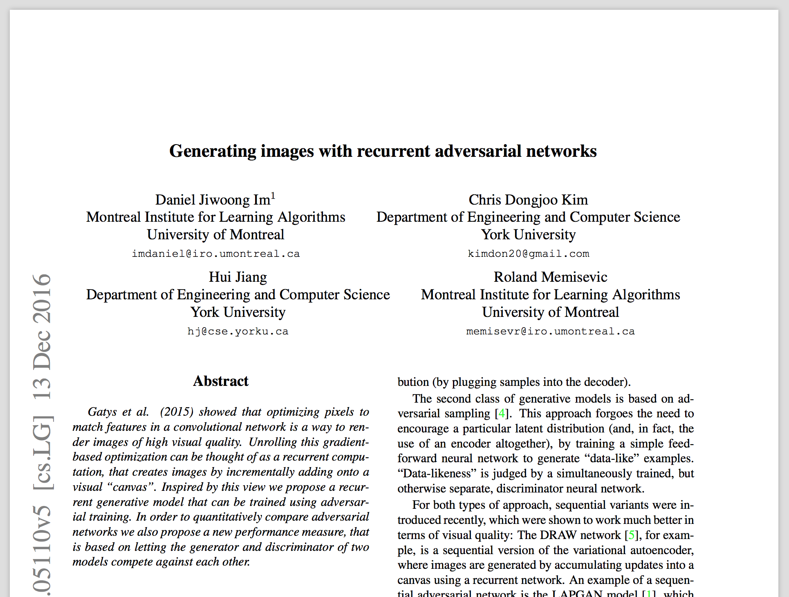
“Generating images with recurrent adversarial networks”

Slide 34
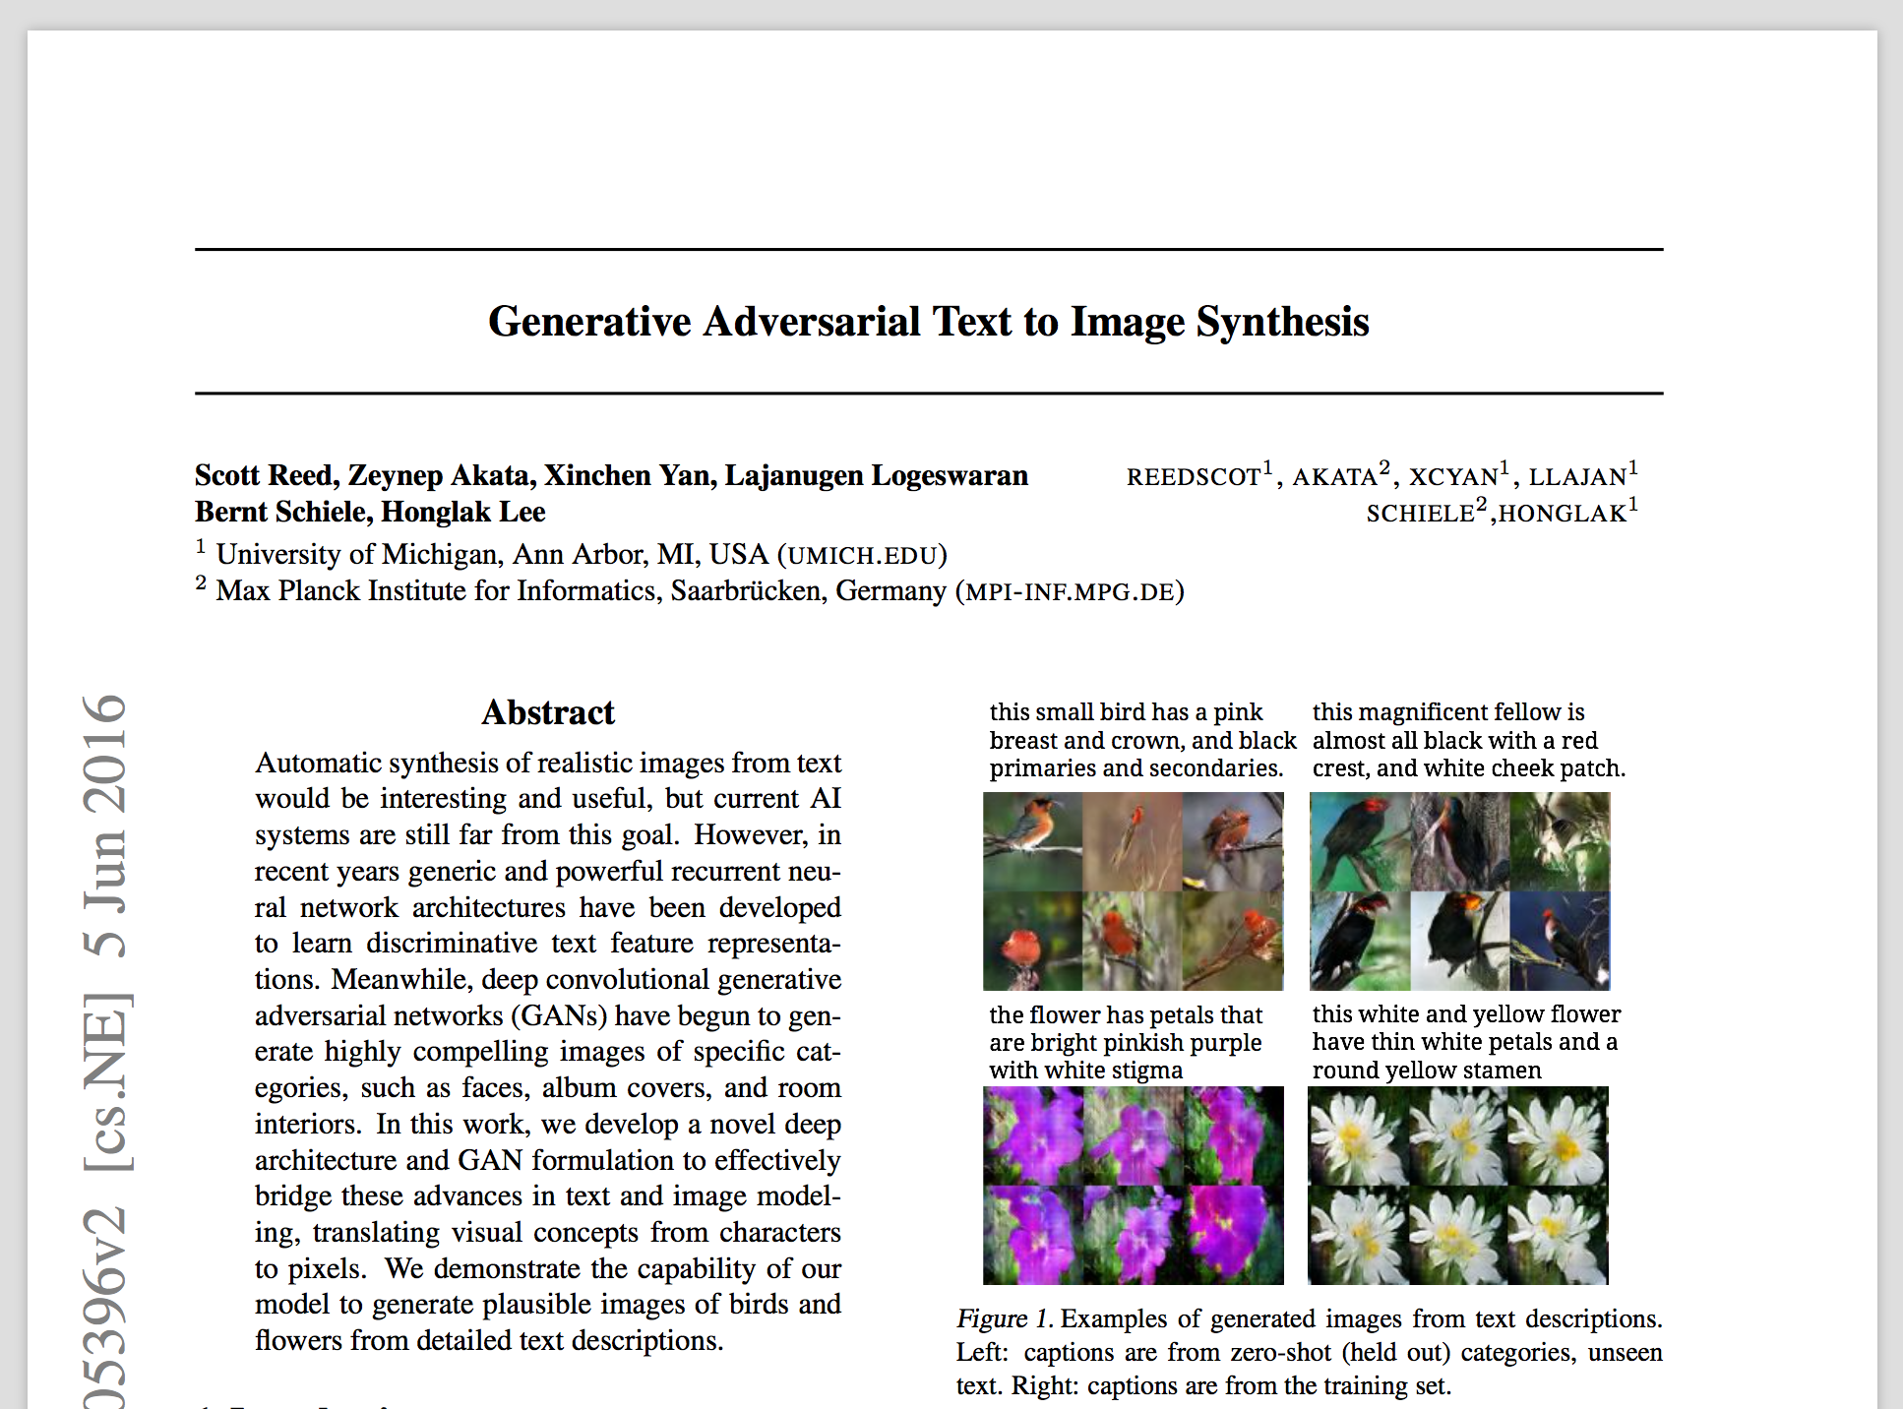
“Generative Adversarial Text to Image Synthesis” — VERY COOL

Slide 35
Bunch of Quora links (Ian Goodfellow, Yoshua Bengio):
https://www.quora.com/What-are-the-pros-and-cons-of-using-generative-adversarial-networks-a-type-of-neural-network
https://www.quora.com/In-what-way-are-Adversarial-Networks-related-or-different-to-Adversarial-Training/answer/Ian-Goodfellow
https://www.quora.com/Do-generative-adversarial-networks-always-converge
https://www.quora.com/What-is-the-advantage-of-generative-adversarial-networks-compared-with-other-generative-models
https://www.quora.com/What-are-some-exciting-future-applications-of-Generative-Adversarial-Networks
https://www.quora.com/What-are-Generative-Adversarial-Networks
https://www.quora.com/Can-Generative-Adversarial-networks-use-multi-class-labels
This one is crazy:
https://www.quora.com/What-is-missing-from-adversarial-networks-for-them-to-truly-model-a-representation-of-the-world
Ian Goodfellow answered this one himself, which is pretty funny:
https://www.quora.com/What-research-directions-is-Ian-Goodfellow-pursuing-to-improve-Generative-Adversarial-Networks
A Youtube Link: https://www.youtube.com/watch?v=deyOX6Mt_As
Brief (spotty) summary:
https://adeshpande3.github.io/Deep-Learning-Research-Review-Week-1-Generative-Adversarial-Nets
OpenAI (Ian Goodfellow works here now): https://openai.com/blog/generative-models/

Slide 36
Here is the original presentation on Google Drive

